Slide 1
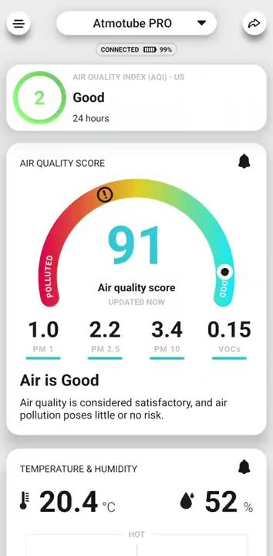
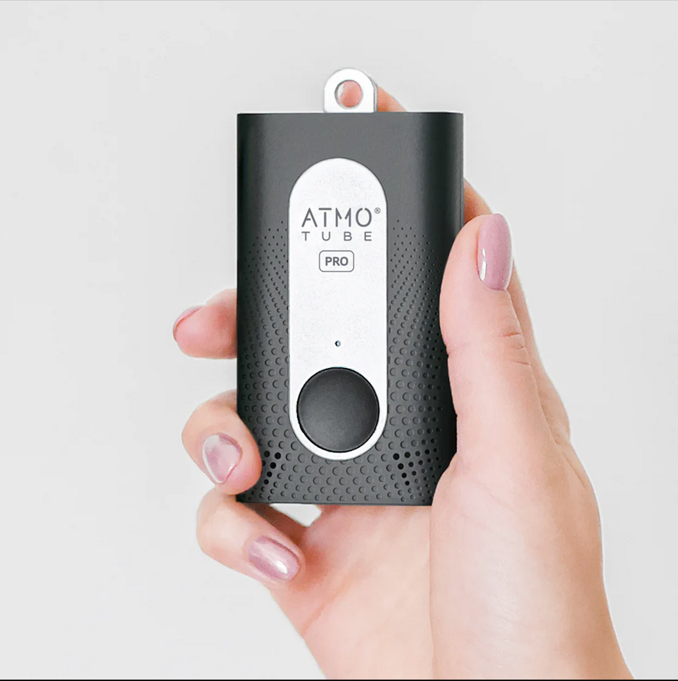
AtmoTube Instructions
Download the Atmotube App (latest version) to a smart device.
Allow Atmotube to use your location (spatial data!)
Enable bluetooth
Allow to use GPS data
Notifications? up to you!
Settings: use precise GPS location.
Check out an atmotube from your instructor.
Look on the back side of your device. There is a white sticker with numbers like this:
#10 B9F7 "CD:B2"
When you connect to a device, ALL of the Atmotubes in our classroom will appear in a list. Find yours, and connect to it.
Are you on an Apple device? Search for the underlined number (like B9F7) to connect to your device.
Are you on an Android device? Search for the full serial number (CD:B2:E1:7B: etc.) The first four digits are on the back of your atmotube, (like "CD:B2")
Select your atmotube and hit "connect."
Did something get confused? Walk far away from all other atmotubes. Close and re-open the Atmotube App. If you are out of bluetooth range, only your device will show up.

